Slide 1

Chapter 24
Congestion Control and
Quality of Service
24.<number>
Copyright © The McGraw-Hill Companies, Inc. Permission required for reproduction or display.

Slide 2
24-2 CONGESTION
Congestion in a network may occur if the load on the network—the number of packets sent to the network—is greater than the capacity of the network—the number of packets a network can handle. Congestion control refers to the mechanisms and techniques to control the congestion and keep the load below the capacity.
Topics discussed in this section:
Network Performance
24.<number>

Slide 3

Figure 24.3 Queues in a router
1. The packet is put at the end of the input queue while waiting to be checked.
2. The processing module of the router removes the packet from the input queue once it reaches the front of the queue and uses its routing table and the destination address to find the route.
3. The packet is put in the appropriate output queue and waits its time to be sent.
24.<number>

Slide 4

Figure Packet delay and throughput as functions of load
24.<number>

Slide 5
24-3 CONGESTION CONTROL
Congestion control refers to techniques and mechanisms that can either prevent congestion, before it happens, or remove congestion, after it has happened. In general, we can divide congestion control mechanisms into two broad categories: open-loop congestion control (prevention) and closed-loop congestion control (removal).
Topics discussed in this section:
Open-Loop Congestion Control
Closed-Loop Congestion Control
24.<number>

Slide 6

Figure 24.5 Congestion control categories
24.<number>

Slide 7
Open Loop Congestion Control
In open-loop congestion control, policies are applied to prevent congestion before it happens. In these mechanisms, congestion control is handled by either the source or the destination.
Retransmission Policy
Retransmission is sometimes unavoidable. If the sender feels that a sent packet is lost or corrupted, the packet needs to be retransmitted. Retransmission in general may increase congestion in the network. However, a good retransmission policy can prevent congestion. The retransmission policy and the retransmission timers must be designed to optimize efficiency and at the same time prevent congestion.
24.<number>

Slide 8
Open Loop Congestion Control
Window Policy
The type of window at the sender may also affect congestion. The Selective Repeat window is better than the Go-Back-N window for congestion control. In the Go-Back-N window, when the timer for a packet times out, several packets may be resent, although some may have arrived safe and sound at the receiver. This duplication may make the congestion worse. The Selective Repeat window, on the other hand, tries to send the specific packets that have been lost or corrupted.
Acknowledgment Policy
The acknowledgment policy imposed by the receiver may also affect congestion. If the receiver does not acknowledge every packet it receives, it may slow down the sender and help prevent congestion.
24.<number>

Slide 9
Open Loop Congestion Control
Discarding Policy
A good discarding policy by the routers may prevent congestion and at the same time may not harm the integrity of the transmission. For example, in audio transmission, if the policy is to discard less sensitive packets when congestion is likely to happen, the quality of sound is still preserved and congestion is prevented or alleviated.
Admission Policy
An admission policy, which is a quality-of-service mechanism, can also prevent congestion in virtual-circuit networks. Switches in a flow first check the resource requirement of a flow before admitting it to the network. A router can deny establishing a virtual circuit connection if there is congestion in the network or if there is a possibility of future congestion.
24.<number>

Slide 10
Closed Loop Congestion Control
Closed-loop congestion control mechanisms try to alleviate congestion after it happens.
24.<number>

Slide 11

Figure 24.6 Backpressure method for alleviating congestion
The backpressure technique can be applied only to virtual circuit
networks, in which each node knows the upstream node from which a flow of data is corning
24.<number>

Slide 12

Figure 24.7 Choke packet
example of this type of control in ICMP.
24.<number>

Slide 13
Implicit Signaling
In implicit signaling, there is no communication between the congested node or nodes and the source.
For example, when a source sends several packets and there is no acknowledgment for a while, one assumption is that the network is congested
24.<number>

Slide 14
Explicit Signaling
The node that experiences congestion can explicitly send a signal to the source or destination. The explicit signaling method, however, is different from the choke packet
method. in the explicit signaling method, the signal is included in the packets that carry data
Backward Signaling
Forward Signaling
24.<number>

Slide 15
24-4 TWO EXAMPLES
To better understand the concept of congestion control, let us give two examples: one in TCP and the other in Frame Relay.
Topics discussed in this section:
Congestion Control in TCP
Congestion Control in Frame Relay
24.<number>

Slide 16
Slow start, exponential increase
One of the algorithms used in TCP congestion control is called slow start. This algorithm is based on the idea that the size of the congestion window (cwnd) starts with one maximum segment size (MSS). The MSS is determined during connection establishment by using an option of the same name. The size of the window increases one MSS each time an acknowledgment is received. As the name implies, the window starts slowly, but grows exponentially.
24.<number>

Slide 17

Figure 24.8 Slow start, exponential increase
24.<number>

Slide 18

Note
In the slow-start algorithm, the size of the congestion window increases exponentially until it reaches a threshold.
24.<number>

Slide 19
Congestion avoidance, additive increase
If we start with the slow-start algorithm, the size of the congestion window increases exponentially. To avoid congestion before it happens, one must slow down this exponential growth. TCP defines another algorithm called congestion avoidance, which undergoes an additive increase instead of an exponential one. When the size of the congestion window reaches the slow-start threshold, the slow-start phase stops and the additive phase begins. In this algorithm, each time the whole window of segments is acknowledged (one round), the size of the congestion window is increased by 1.
24.<number>

Slide 20

Figure 24.9 Congestion avoidance, additive increase
24.<number>

Slide 21
Note
In the congestion avoidance algorithm, the size of the congestion window increases additively until
congestion is detected.
24.<number>

Slide 22
Congestion detection, multiplicative decrease
If congestion occurs, the congestion window size must be decreased. The only way the sender can guess that congestion has occurred is by the need to retransmit a segment. However, retransmission can occur in one of two cases: when a timer times out or when three ACKs are received. In both cases, the size of the threshold is dropped to one-half, a multiplicative decrease.
24.<number>

Slide 23
Congestion detection, multiplicative decrease-case:1
If a time-out occurs, there is a stronger possibility of congestion; a segment has probably been dropped in the network, and there is no news about the sent segments. In this case TCP reacts strongly:
a. It sets the value of the threshold to one-half of the current window size.
b. It sets cwnd to the size of one segment.
c. It starts the slow-start phase again.
24.<number>

Slide 24
Congestion detection, multiplicative decrease-case:2
If three ACKs are received, there is a weaker possibility of congestion; a segment may have been dropped, but some segments after that may have arrived safely since three ACKs are received. This is called fast transmission and fast recovery. In this case, TCP has a weaker reaction:
a. It sets the value of the threshold to one-half of the current window size.
b. It sets cwnd to the value of the threshold (some implementations add three segment sizes to the threshold).
c. It starts the congestion avoidance phase.
24.<number>

Slide 25
Note
An implementation reacts to congestion detection in one of the following ways:
❏ If detection is by time-out, a new slow
start phase starts.
❏ If detection is by three ACKs, a new
congestion avoidance phase starts.
24.<number>

Slide 26

Figure 24.10 TCP congestion policy summary
24.<number>

Slide 27

Figure 24.11 Congestion example
24.<number>

Slide 28
24-5 QUALITY OF SERVICE
Quality of service (QoS) is an internetworking issue that has been discussed more than defined. We can informally define quality of service as something a flow seeks to attain.
Topics discussed in this section:
Flow Characteristics
Flow Classes
24.<number>

Slide 29

Figure 24.15 Flow characteristics
24.<number>

Slide 30
24-6 TECHNIQUES TO IMPROVE QoS
In Section 24.5 we tried to define QoS in terms of its characteristics. In this section, we discuss some techniques that can be used to improve the quality of service. We briefly discuss four common methods: scheduling, traffic shaping, admission control, and resource reservation.
Topics discussed in this section:
Scheduling
Traffic Shaping
Resource Reservation
Admission Control
24.<number>

Slide 31

Figure 24.16 FIFO queue
In first-in, first-out (FIFO) queuing, packets wait in a buffer (queue) until the node (router or switch) is ready to process them. If the average arrival rate is higher than the average processing rate, the queue will fill up and new packets will be discarded. A FIFO queue is familiar to those who have had to wait for a bus at a bus stop.
24.<number>

Slide 32

Figure 24.17 Priority queuing
In priority queuing, packets are first assigned to a priority class. Each priority class has its own queue. The packets in the highest-priority queue are processed first. Packets in the lowest-priority queue are processed last. Note that the system does not stop serving a queue until it is empty.
24.<number>

Slide 33

Figure 24.18 Weighted fair queuing
A better scheduling method is weighted fair queuing. In this technique, the packets are still assigned to different classes and admitted to different queues. The queues, however, are weighted based on the priority of the queues.
24.<number>

Slide 34
Traffic Shaping Leaky bucket
If a bucket has a small hole at the bottom, the water leaks from the bucket at a constant rate as long as there is water in the bucket. The rate at which the water leaks does not depend on the rate at which the water is input to the bucket unless the bucket is empty. The input rate can vary, but the output rate remains constant. Similarly, in networking, a technique called leaky bucket can smooth out bursty traffic. Bursty chunks are stored in the bucket
and sent out at an average rate.
24.<number>

Slide 35

Traffic Shaping
Figure 24.19 Leaky bucket
24.<number>

Slide 36

Figure 24.20 Leaky bucket implementation
The following is an algorithm for variable-length packets:
1. Initialize a counter to n at the tick of the clock.
2. If n is greater than the size of the packet, send the packet and decrement the counter by the packet size. Repeat this step until n is smaller than the packet size.
3. Reset the counter and go to step 1.
24.<number>

Slide 37
Note
A leaky bucket algorithm shapes bursty traffic into fixed-rate traffic by averaging the data rate. It may drop the packets if the bucket is full.
24.<number>

Slide 38
Note
The token bucket allows bursty traffic at a regulated maximum rate.
24.<number>

Slide 39
Token bucket
The leaky bucket is very restrictive. It does not credit an idle host. For example, if a host is not sending for a while, its bucket becomes empty. Now if the host has bursty data, the leaky bucket allows only an average rate. The time when the host was idle is not taken into account. On the other hand, the token bucket algorithm allows idle hosts to accumulate credit for the future in the form of tokens. For each tick of the clock, the system sends n tokens to the bucket. The system removes one token for every cell (or byte) of data sent.
24.<number>

Slide 40

Figure 24.21 Token bucket
24.<number>

Slide 41
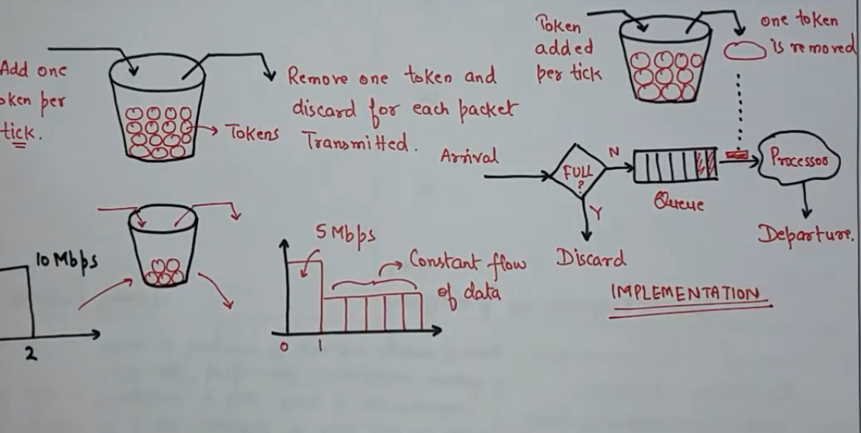
24.<number>

Slide 42
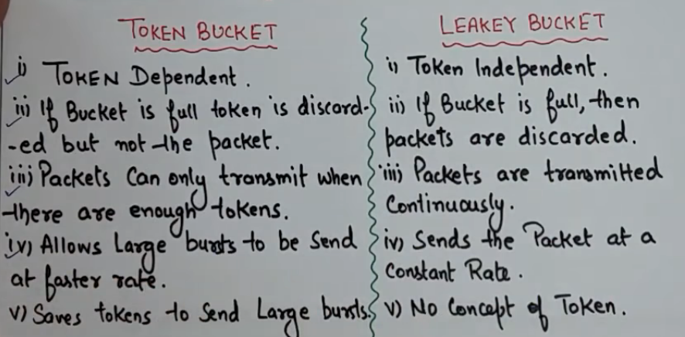
24.<number>

Slide 43
Resource Reservation
A flow of data needs resources such as a buffer, bandwidth, CPU time, and so on. The quality of service is improved if these resources are reserved beforehand.
Admission Control
Admission control refers to the mechanism used by a router, or a switch, to accept or reject a flow based on predefined parameters called flow specifications. Before a router accepts a flow for processing, it checks the flow specifications to see if its capacity (in terms of bandwidth, buffer size, CPU speed, etc.) and its previous commitments to other flows can handle the new flow.
24.<number>

